Slide 1
SAY GOODBYE TO
EARTH ENGLISH
LANGUAGE CHANGE DURING INTERSTELLAR TRAVEL
Nauvoo/Behemoth/Medina Station
From The Expanse
ANDREW MCKENZIE

Slide 2
Wait– interstellar travel?

Slide 3

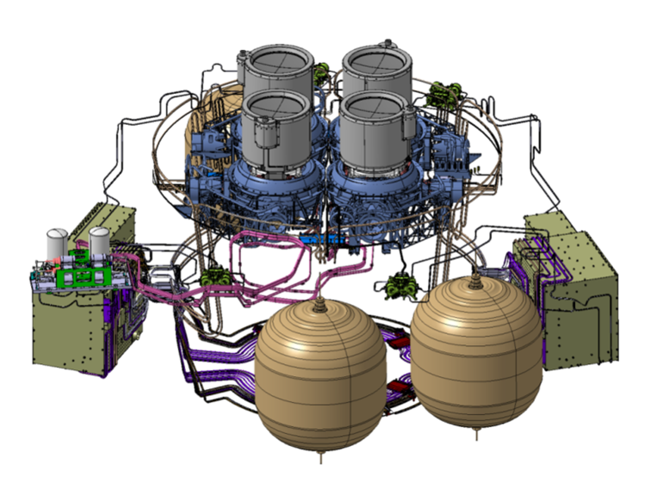

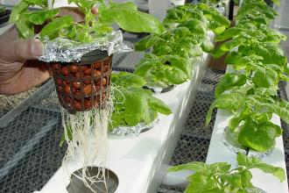

Advance Concepts Team
Technical questions
Biological questions
Human questions

Slide 4
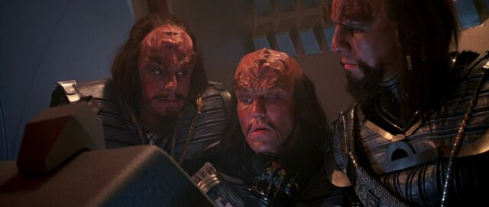
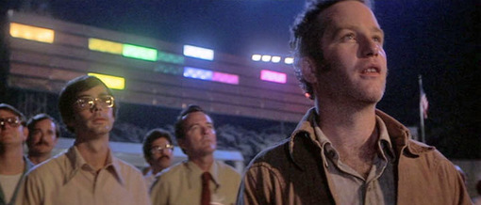
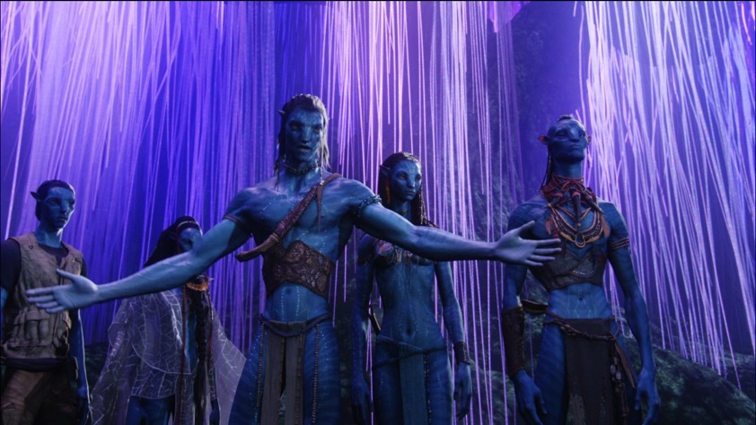
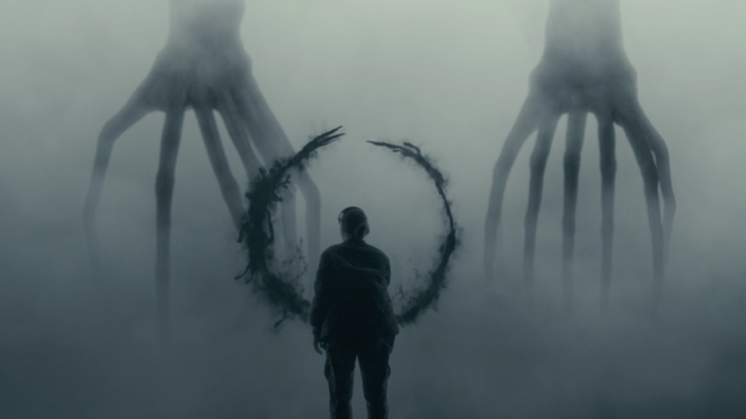
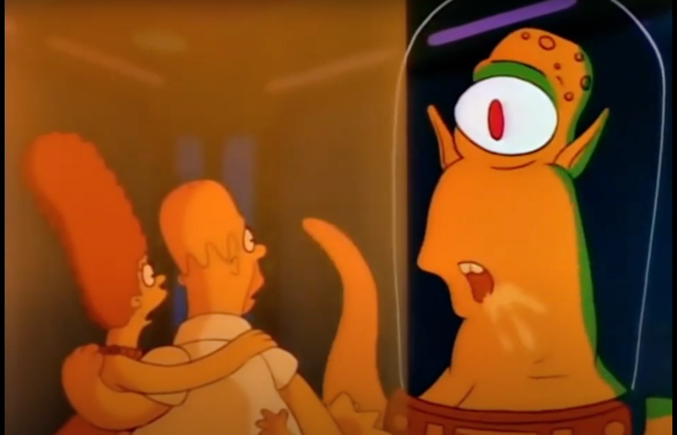
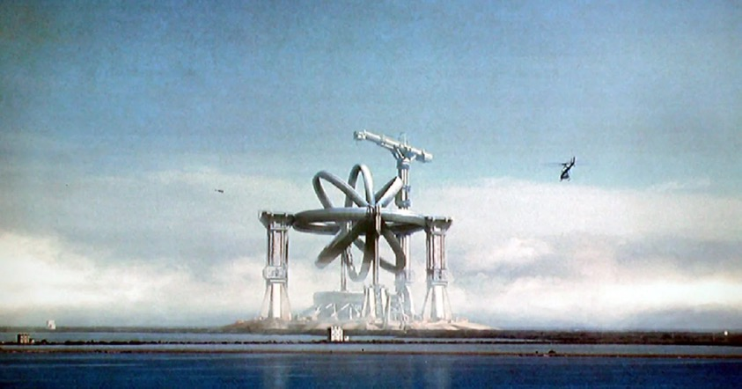
Not your usual xenolinguistics
Star Trek III: The Search for Spock (1984)
Close Encounters of the Third Kind (1979)
Avatar (2019)
Arrival (2019)
The Simpsons s2e3 (1990)
Contact (1997)

Slide 5
The basic research question
In a generation ship spending hundreds of years to reach a new destination… What will happen to the language(s) on board?

Slide 6
Quick rundown
We cannot predict exactly what will happen Except that change WILL happen
Interstellar travel = ideal environment
Comparing to Earth-bound examples can prepare us

Slide 7
How language change works

Slide 8
Languages as systems
A language is a system of systems
Inasmuch as a language even exists...
Changes are systematic
voiceless stops
became
voiceless fricatives
father [f]
three [θ]
hound [h]
what [hw] → [w]
pater [p]
tres [t]
canis [k]
quod [kw]

Slide 9
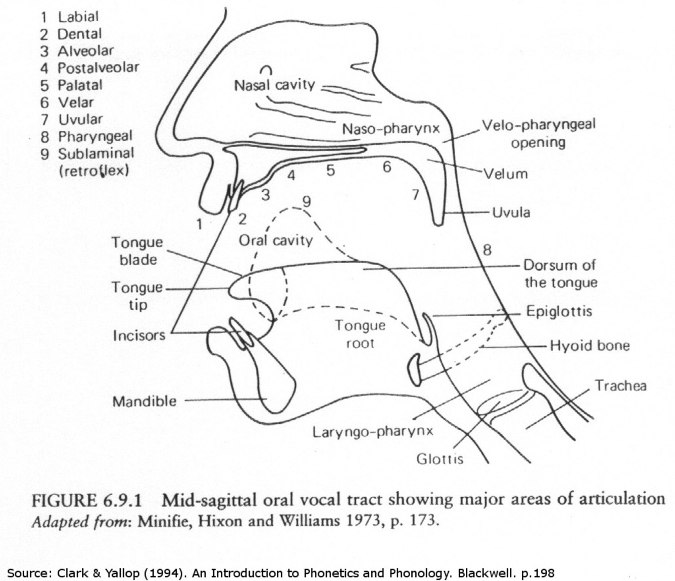
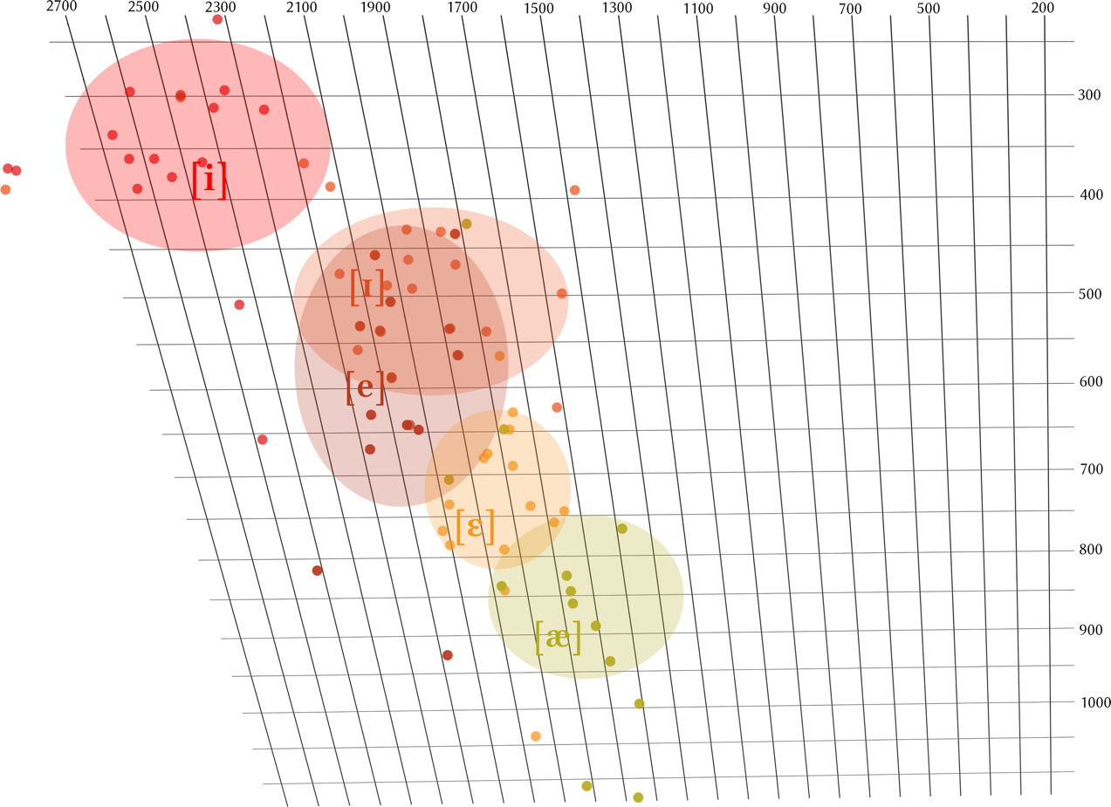
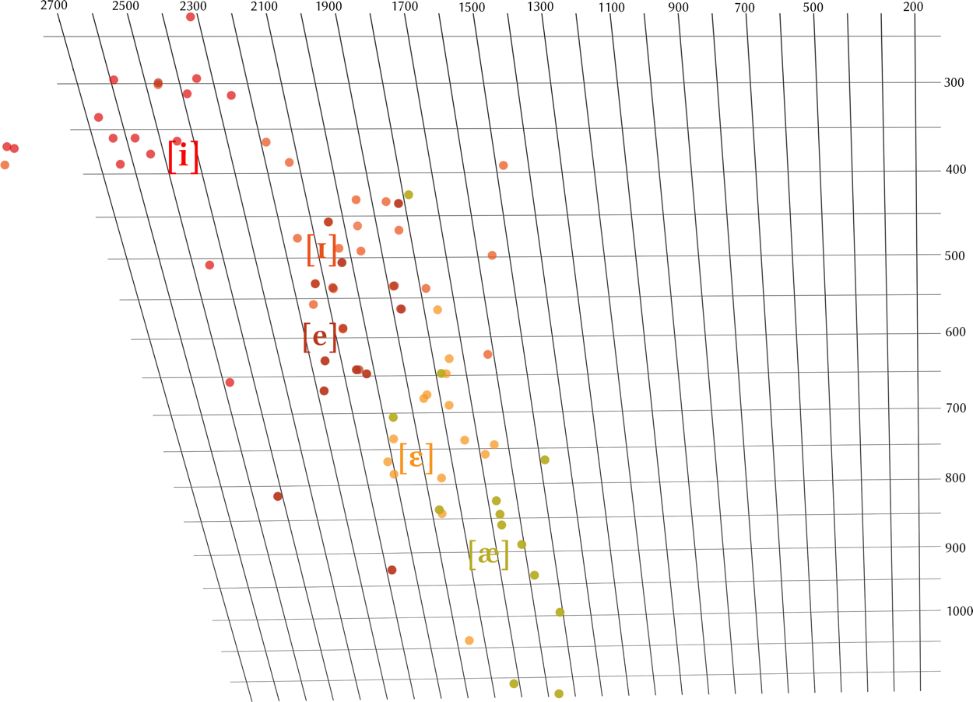
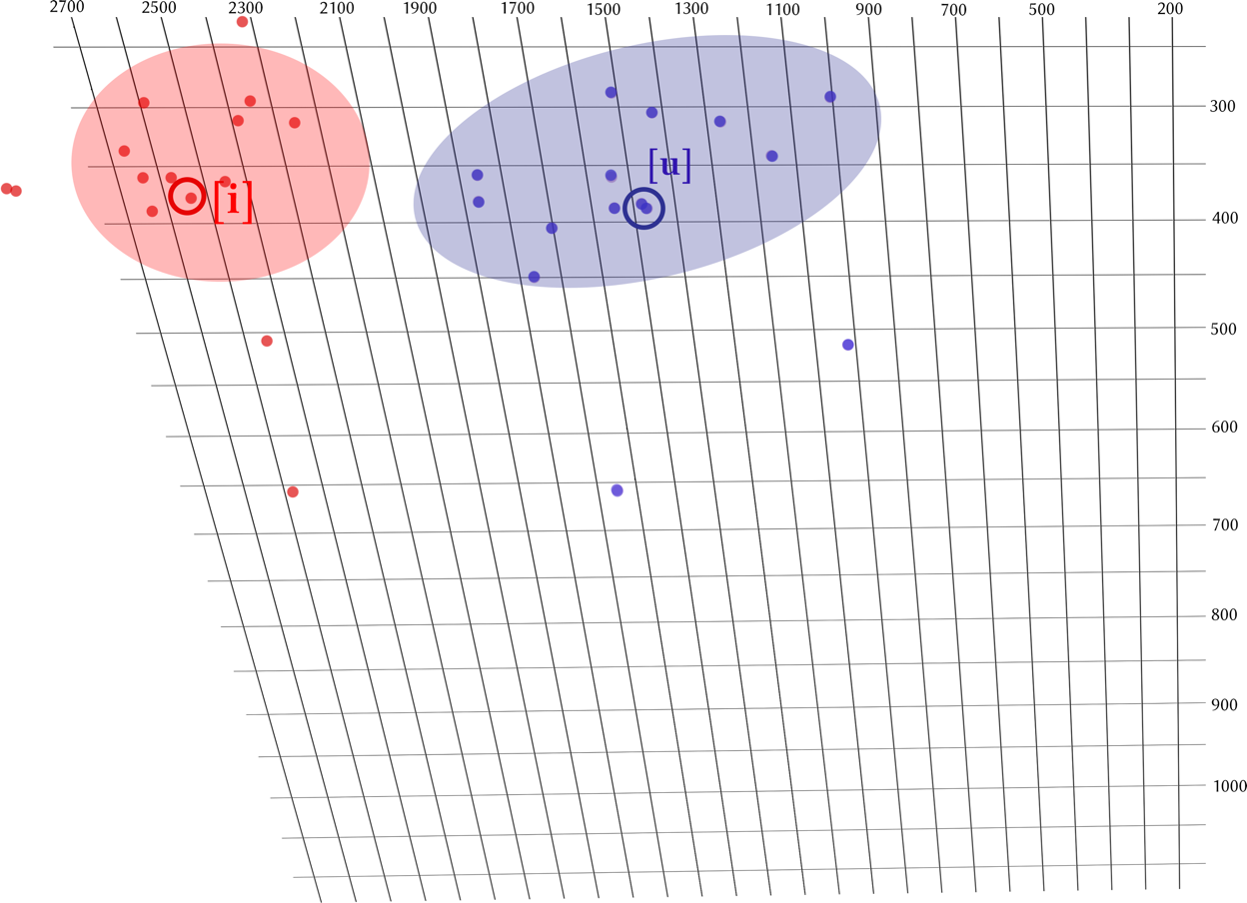
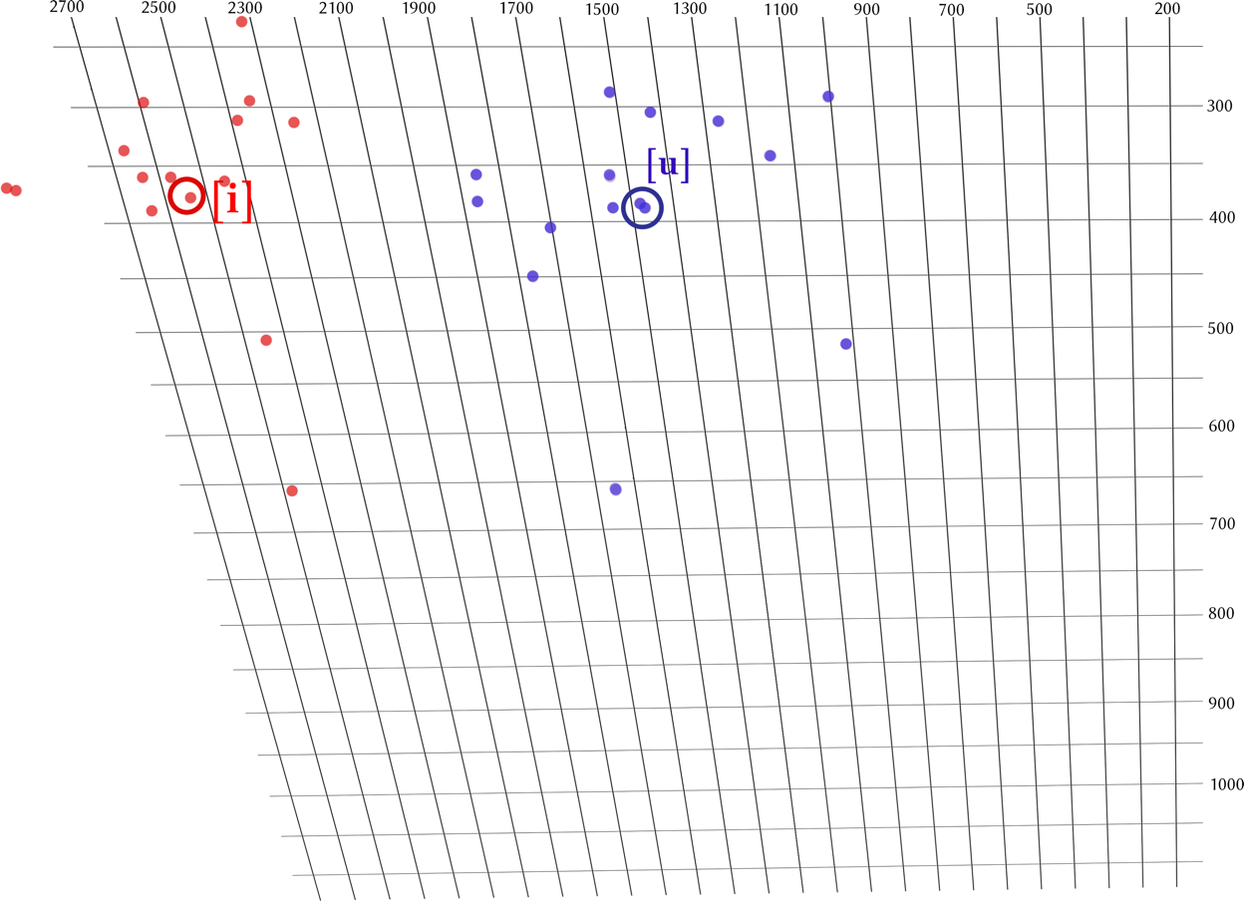
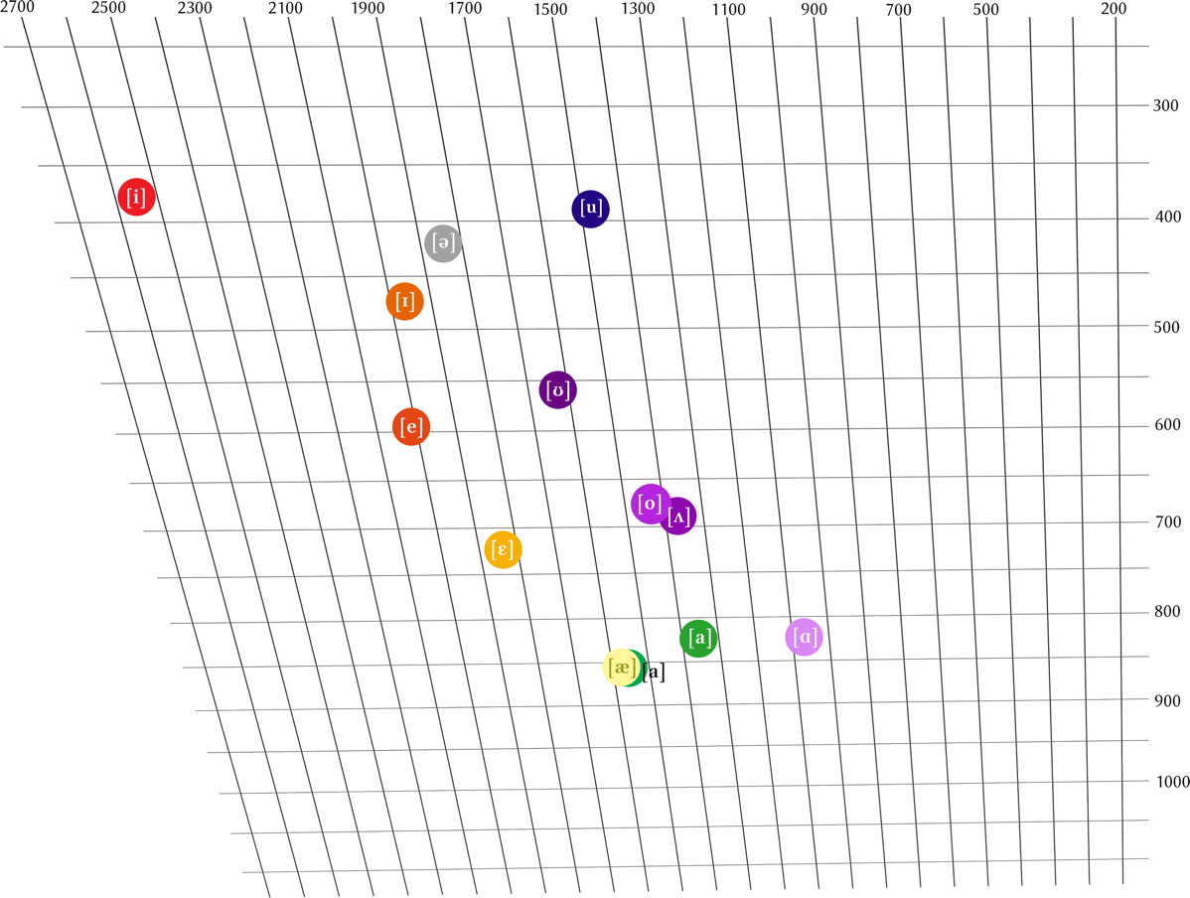

Slide 10
An example of a major change
1400
GREAT
VOWEL
SHIFT
mite
[iː]
bout
[uː]
meet
[eː]
boot
[oː]
LIPS
meat
[εː]
boat
[ɔː]
mate
[aː]
THROAT
TONGUE

Slide 11
An example of a major change
1420
GREAT
VOWEL
SHIFT
mite
[iː]
bout
[uː]
meet
boot
[eː]
[oː]
meat
boat
LIPS
[εː]
[ɔː]
mate
[aː]
THROAT
TONGUE

Slide 12
An example of a major change
1440
GREAT
VOWEL
SHIFT
[iː]
bout
[uː]
mite
meet
boot
[eː]
[oː]
meat
boat
LIPS
[εː]
[ɔː]
mate
[aː]
THROAT
TONGUE

Slide 13
An example of a major change
1460
GREAT
VOWEL
SHIFT
[iː]
[uː]
meet
mite
bout
boot
mite
bout
meat
[eː]
boat
[oː]
LIPS
[εː]
[ɔː]
mate
[aː]
THROAT
TONGUE

Slide 14
An example of a major change
1480
GREAT
VOWEL
SHIFT
meet
[iː]
[uː]
mite
bout
boot
meat
[eː]
mite
bout
boat
[oː]
[ə]
LIPS
mate
[εː]
[ɔː]
[aː]
THROAT
TONGUE

Slide 15
An example of a major change
1500
GREAT
VOWEL
SHIFT
meet
[iː]
mite
bout
boot
[uː]
meat
[eː]
boat
[oː]
mite
bout
[ə]
mate
[εː]
[ɔː]
LIPS
[aː]
THROAT
TONGUE

Slide 16
An example of a major change
1600
GREAT
VOWEL
SHIFT
meet
[iː]
mite
bout
boot
[uː]
meat
mate
[eː]
boat
[oː]
[ə]
LIPS
[εː]
[ɔː]
mite
bout
[aː]
THROAT
TONGUE

Slide 17
And these still happen!
1930
NORTHERN
CITIES
VOWEL
SHIFT
[i]
[u]
[ɪ]
kit
[e]
[o]
[ə]
LIPS
dress
[ε]
strut
caught
[ɔ]
cot
[ɑ]
trap
[æ]
[aː]
THROAT
TONGUE

Slide 18
And these still happen!
1950
NORTHERN
CITIES
VOWEL
SHIFT
[i]
[u]
[ɪ]
kit
[e]
[o]
[ə]
LIPS
dress
[ε]
strut
caught
[ɔ]
trap
cot
[ɑ]
[æ]
[aː]
THROAT
TONGUE

Slide 19
And these still happen!
1970
NORTHERN
CITIES
VOWEL
SHIFT
[i]
[u]
[ɪ]
kit
[e]
[o]
[ə]
LIPS
trap
[ε]
dress
strut
[ɔ]
caught
cot
[ɑ]
[æ]
[aː]
THROAT
TONGUE

Slide 20
And these still happen!
1980
NORTHERN
CITIES
VOWEL
SHIFT
[i]
[u]
[ɪ]
[e]
kit
[o]
trap
[ə]
LIPS
trap
[ε]
dress
strut
[ɔ]
caught
[ɑ]
[æ]
cot
[aː]
THROAT
TONGUE

Slide 21
Some other big changes
þæt ic þas boc awende
that I that book translated
`that I translated that book’
þæt ic þas boc awende
that I that book translated
`that I translated that book’
with this ring I thee wed
‘til death do us part
one swallow does not a summer make

Slide 22
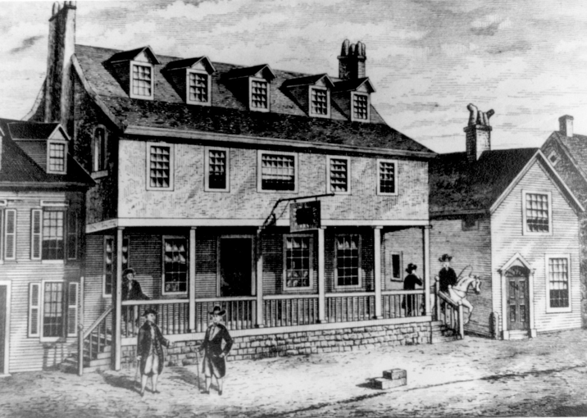
Some other recent changes
My house is currently being built
My house is currently building
My house is getting built

Slide 23
What causes these changes?

Slide 24
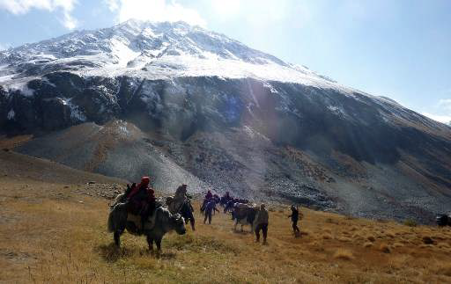
What drives divergence
The rate and extent of change depends on social factors
(lack of) contact
(social) identity

Slide 25
Historical comparisons

Slide 26
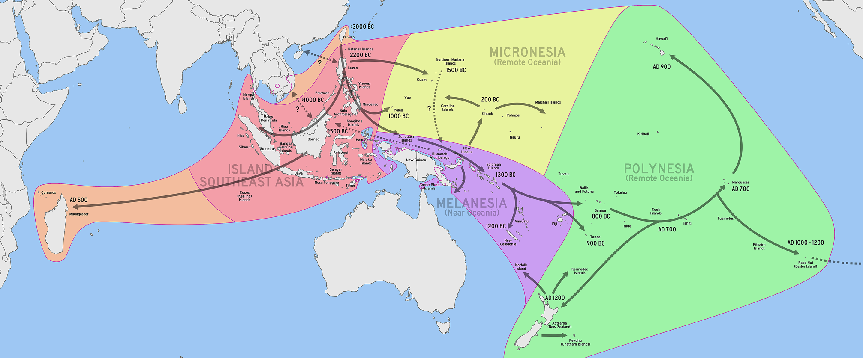
Oceanic colonization
Austronesian languages
>3000 BC
Hawai’ian
Chamorro
2200 BC
AD 900
Tagalog
1500 BC
very little
outside influence
Malay
>1000 BC
800 BC
AD 500
Bantu
1300 BC
Indonesian
Samoan
AD 700
1200 BC
AD 700
AD 1000
900 BC
Rapa Nui
Malagasy
heavy influence from Bantu
AD 1200
Maōri

Slide 27
Dutch → Afrikaans

Slide 28
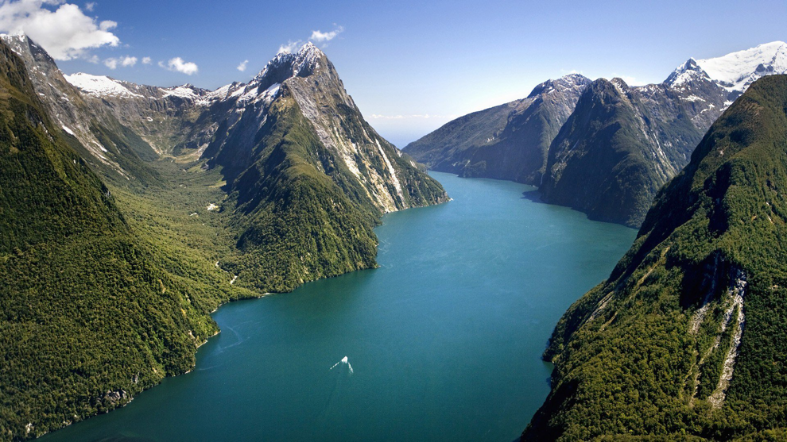
New Zealand English
In 3 generations a dialect formed
( koinéization )
relative isolation → convergence
dominant social community

Slide 29
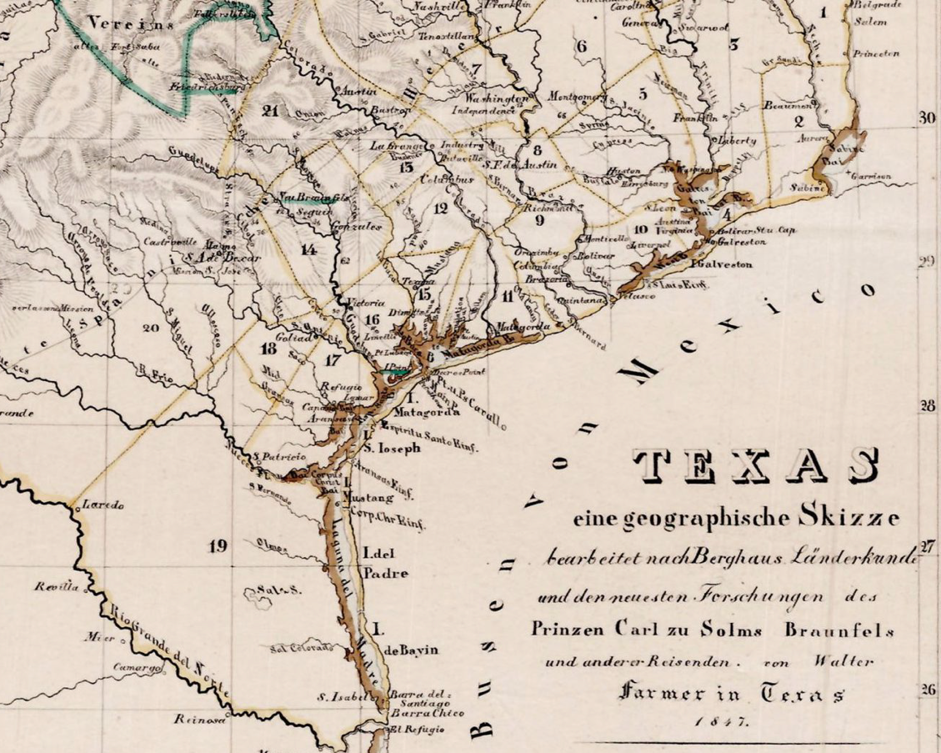
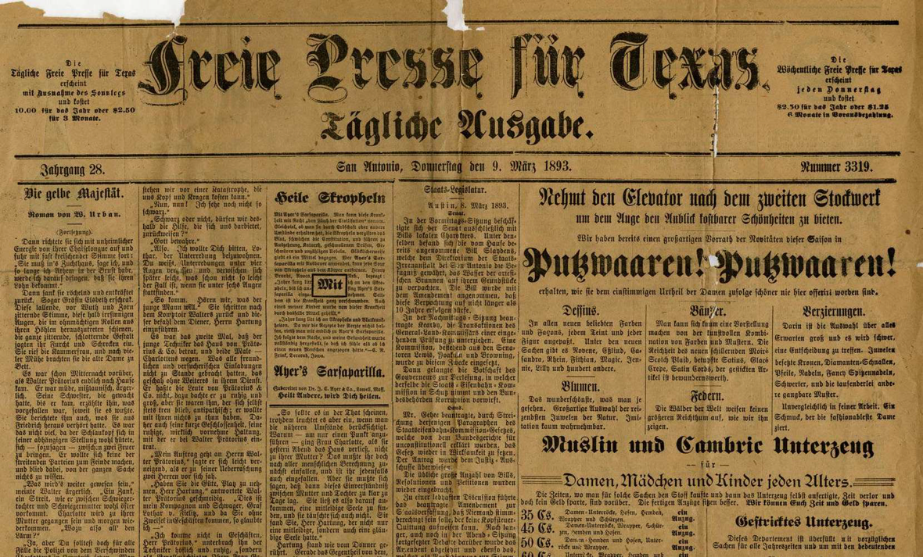
Texas German
German-speaking colonists
(1840s – World War I)
Dialects merged into new variety
(Texas German)
Koinéization incomplete
Perhaps due to minority status

Slide 30
Let’s sum up the social factors
promotes koinéization
isolation
long time
higher social status
inhibits koinéization
contact
short time
lower social status

Slide 31
So what can we expect?

Slide 32
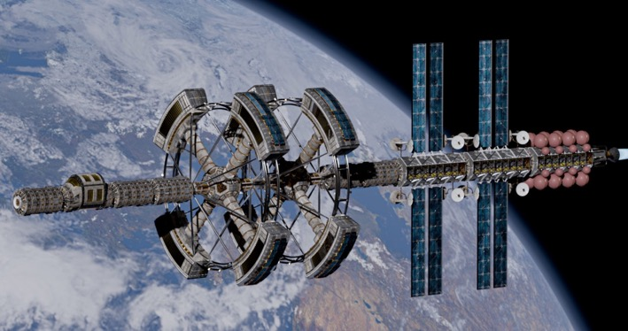

Goodbye Earth English
a new variety (dialect / language) will emerge
people will stop using “Earth English”
Earth is the pale blue dot

Slide 33
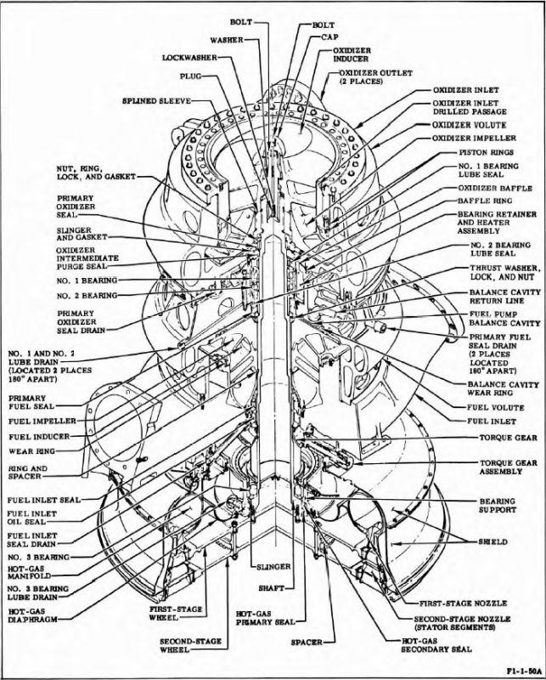
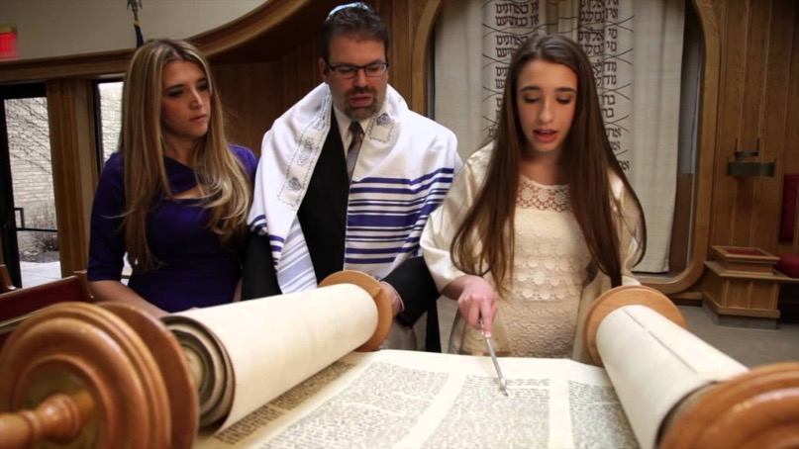
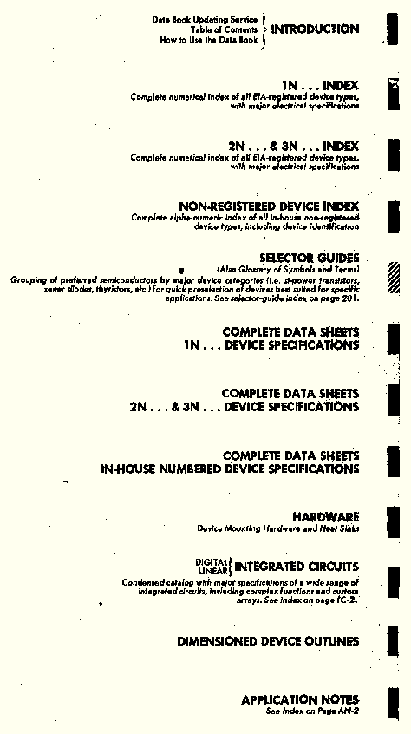
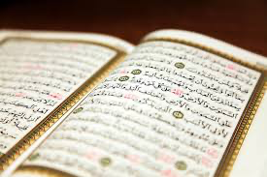
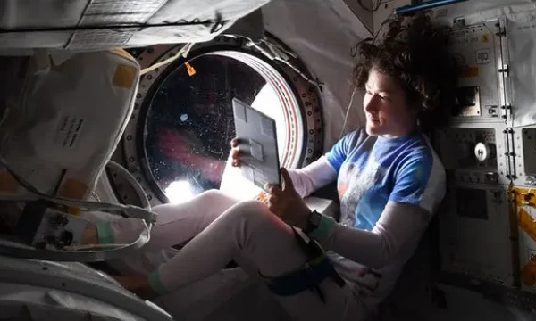
Ritualistic remnants

Slide 34
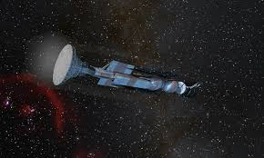
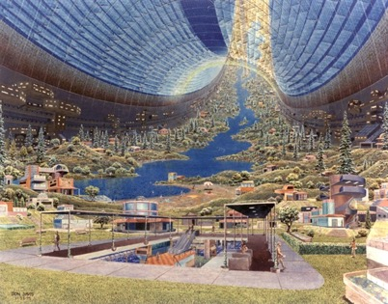
What happens when they arrive?
Every ship will make
its own variety
The ship will make
its own variety
Their new home?
a healthy convergence
social concord
a bitter divergence
social stratification

Slide 35
Considerations for modernity

Slide 36
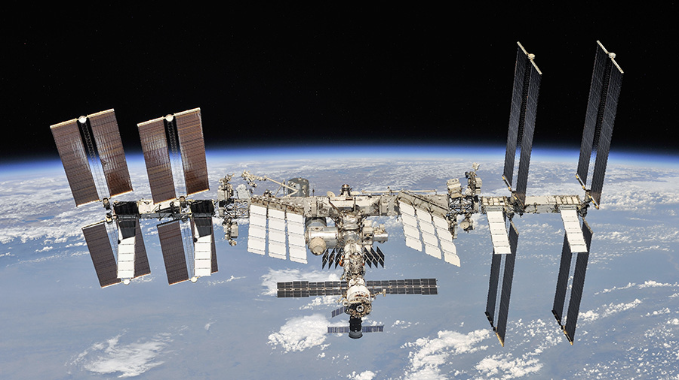
Language policy
lingua franca
the ISS has no
policy... for now
translations
official language(s)

Slide 37
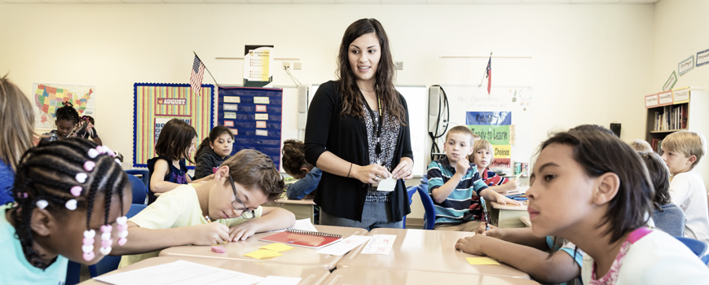
Education
strong factor for convergence
promotes a prestige variety

Slide 38
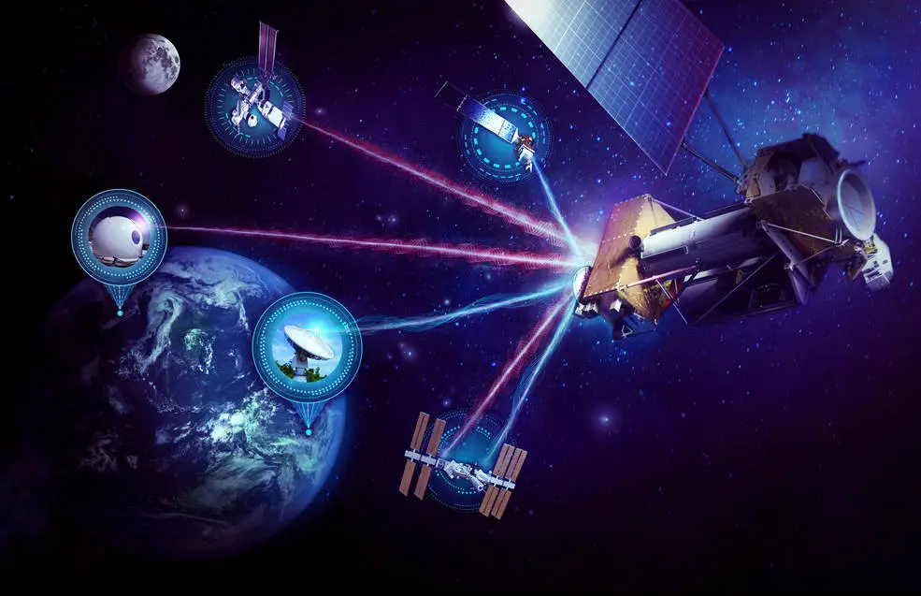
Telecommunications
Promotes convergence... while it lasts

Slide 39
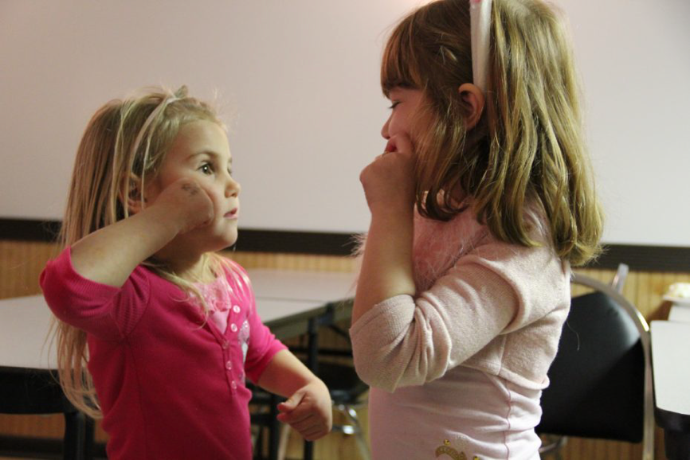
Sign Languages
>2 in 1,000 births
congenital hearing loss
sign languages
≠
spoken languages
(and these will change too!)

Slide 40
Conclusions

Slide 41
Predictions
The language on board will change
(as will language back on Earth)
How it changes = proxy of social development
Language upon arrival can be tricky

Slide 42
Recommendations
More linguists on board
More linguistic awareness on board
Explicit language policy

Slide 43


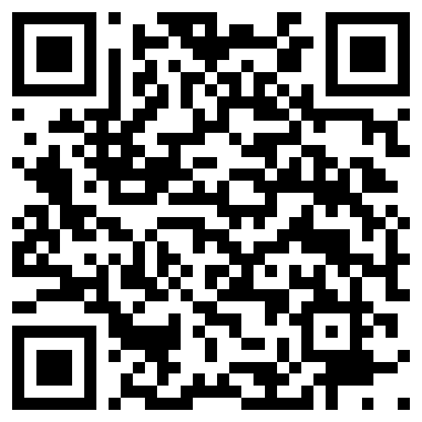
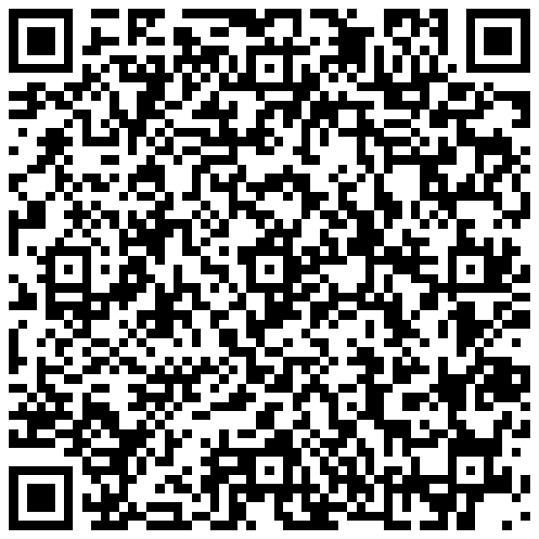
Thank you!
Download this article
from Acta Futura
Check out this volume
on xenolinguistics
andrew.mckenzie@ku.edu

